Slide 1



CELLULA GO
EDA
Present by The Team
github
gmail

Slide 2



TODAY'S AGENDA
1
Introduction
5
Multivariate analysis
2
Problem Statement
6
Map analysis
3
Our Innovative Solutions
7
Dashboard
4
Univariate analysis
8
Thanks

Slide 3
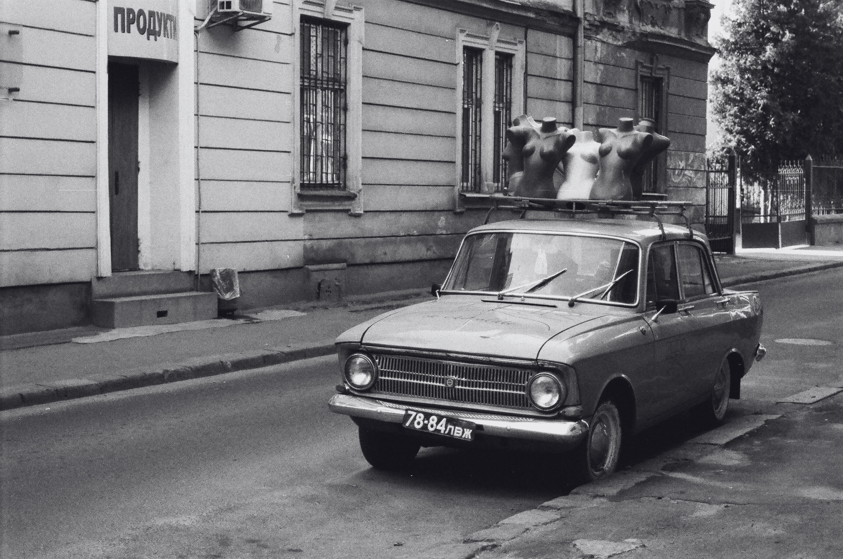
INTRODUCTION
Welcome to our Week 4 Cellula Internship project presentation. Our team has conducted a comprehensive Exploratory Data Analysis that we're excited to share with you today. Through this analysis, we've uncovered meaningful insights and patterns in our dataset that tell an interesting story.
In this presentation, we'll guide you through:
Our key findings and discoveries
Visual representations of the data patterns
Important trends and correlations we've identified
Actionable insights derived from our analysis

Slide 4

The amount of the data
500000 rows is a bit too much for our computers to handle,
it would take pandas approximately 9 seconds to just read the data as a CSV file, so it was a problem to manipulate that dataset with pandas that are written with
Python: ~60-70%
Cython: ~20-30%
C: ~5-10%
NumPy (Python, C, Fortran): ~5-10%
Our data is not real
Unfortunately, our data has been severely compromised, with a significant portion of it rendered completely unusable or, at the very least, highly corrupted. This unfortunate reality will become starkly apparent as we delve into the visualization section of our analysis, where the flaws and inaccuracies in the data will be starkly illuminated. Despite our best efforts to salvage what we could, the damage is too extensive, and we are left with a dataset that is, quite frankly, unreliable.
PROBLEM STATEMENT

Slide 5




OUR INNOVATIVE SOLUTIONS
Using polars instead of pandas
We need to generate more data
This strategic choice significantly boosts our analytical capabilities through Polars' superior performance. Thanks to its Rust-based implementation and advanced parallel processing, Polars executes operations up to 10 times faster than pandas
Due to corruption in our existing dataset. When faced with corrupted or compromised data, we employ sophisticated data generation techniques to reconstruct and supplement our analysis. Through statistical modeling, interpolation methods, and advanced data imputation techniques

Slide 6
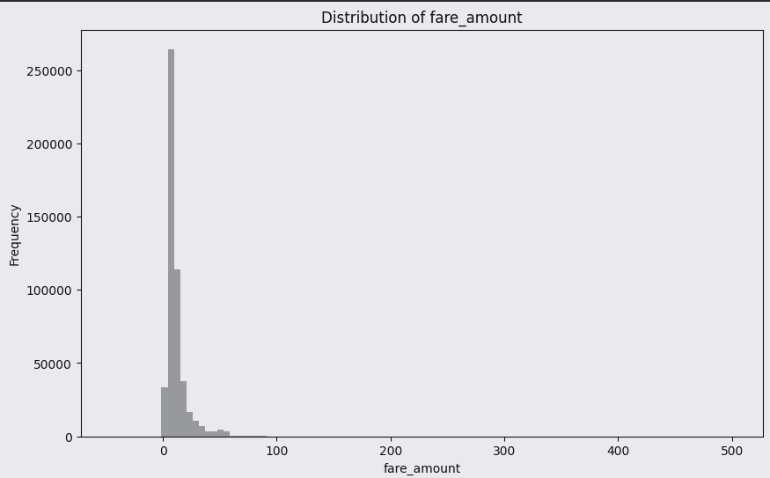
UNIVARIATE ANALYSIS
Fare Distribution
This histogram shows fare amounts, demonstrating a highly right-skewed distribution. The majority of fares cluster between $0-50, with a long tail extending to around $500. This pattern suggests most rides are relatively short/inexpensive, with fewer premium or long-distance trips.

Slide 7
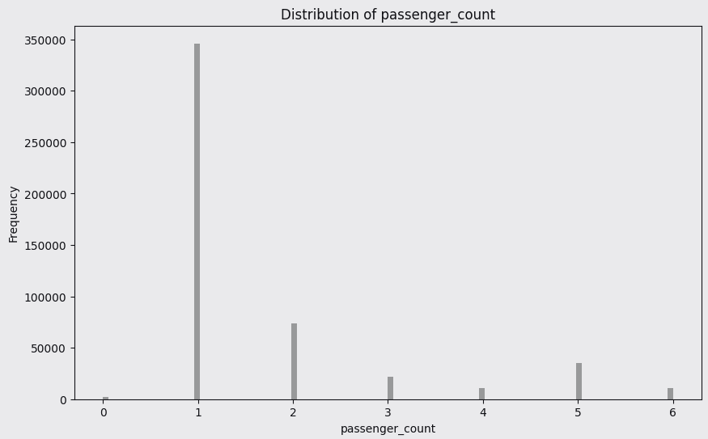
UNIVARIATE ANALYSIS
Passenger Count Distribution
This bar chart displays the number of passengers per ride. Single passengers are most common, followed by 2 passengers. There's a steady decline in frequency as passenger count increases up to 6, showing that larger groups are less common.

Slide 8
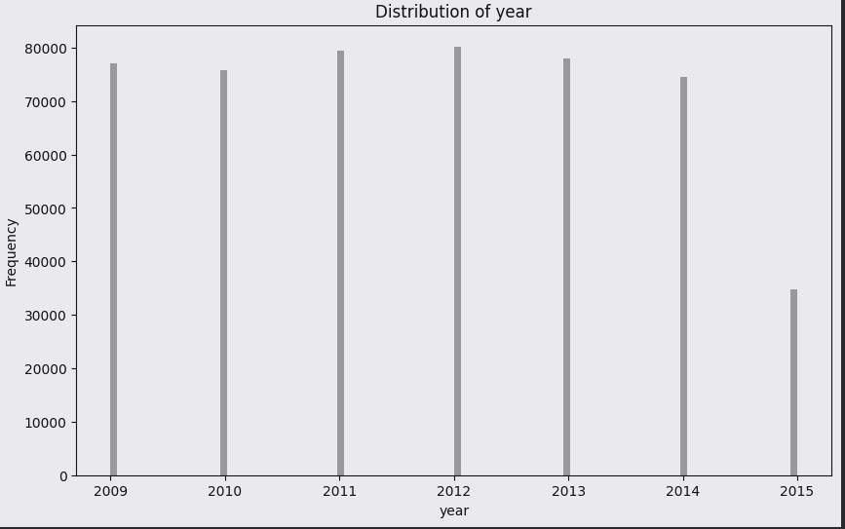
UNIVARIATE ANALYSIS
Yearly Trip Distribution
This time series bar chart shows trip volumes from 2009-2015. Trip volumes remained fairly stable between 2009-2014 (around 70,000-80,000 trips), with a notable decline in 2015 to about 35,000 trips, suggesting a significant change in that year.

Slide 9
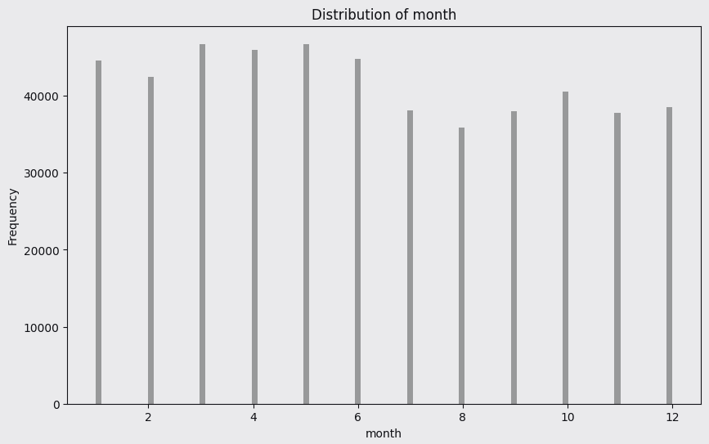
UNIVARIATE ANALYSIS
Monthly Trip Distribution
This bar chart shows trip distribution across months (1-12). Trip volumes are relatively consistent throughout the year, with slight variations. The busiest months appear to be in early spring (months 3-4), while slightly lower volumes occur in late summer/early fall.

Slide 10
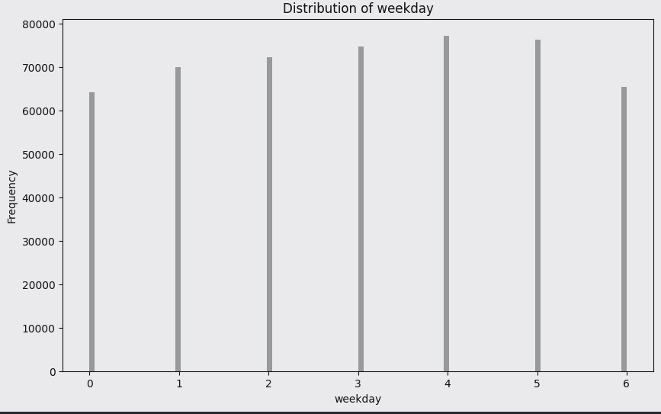
UNIVARIATE ANALYSIS
Weekday Trip Distribution
This bar chart shows trip distribution across days of the week (0-6, likely Sunday-Saturday). Trip volumes are fairly consistent across weekdays, with slightly higher volumes mid-week (days 3-4) and slightly lower volumes on weekends (days 0 and 6), suggesting a business-driven pattern.

Slide 11
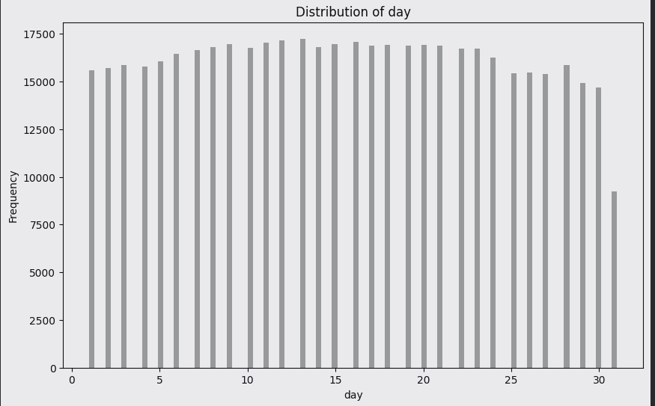
UNIVARIATE ANALYSIS
Daily Trip Distribution
This bar chart shows trip distribution across days of the month (1-31). The distribution is relatively uniform throughout most of the month (around 15,000-17,500 trips per day), with a slight decline towards the end of the month. The notable drop on day 31 is likely due to fewer months having 31 days, making the sample size smaller for that day.

Slide 12
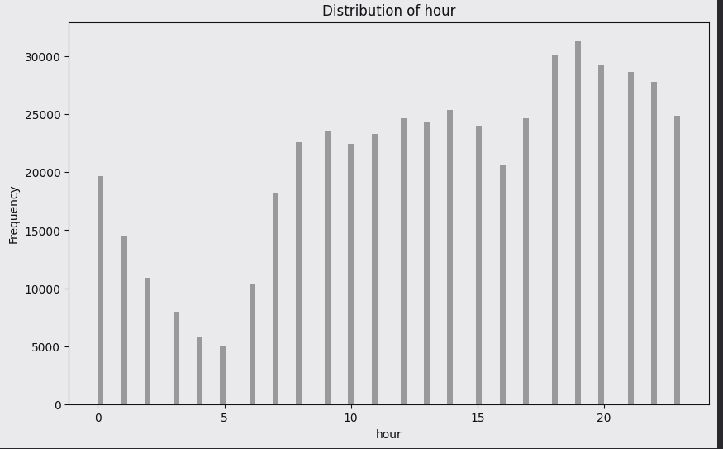
UNIVARIATE ANALYSIS
Hourly Trip Distribution
This bar chart displays trip frequency by hour of the day (0-23). There's a clear pattern showing:
Low activity during early morning hours (2-5 AM)
Morning rush hour peak around 8-9 AM
Sustained activity during business hours
Highest peak during evening rush hour (17-19)
Gradual decline in late evening This pattern reflects typical urban transportation patterns with commuting peaks.

Slide 13
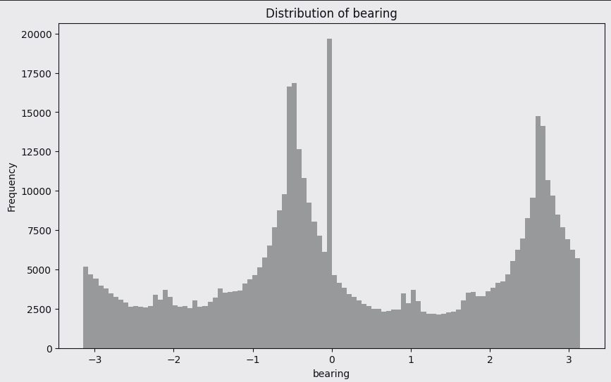
UNIVARIATE ANALYSIS
Bearing Distribution
This histogram shows the distribution of directional bearings, measured in radians from -π to π. There are two prominent peaks around 0 and 2π/3, suggesting two primary travel directions in the dataset. This pattern could indicate major transportation corridors or common routes in the area, with most trips following these predominant directions.

Slide 14
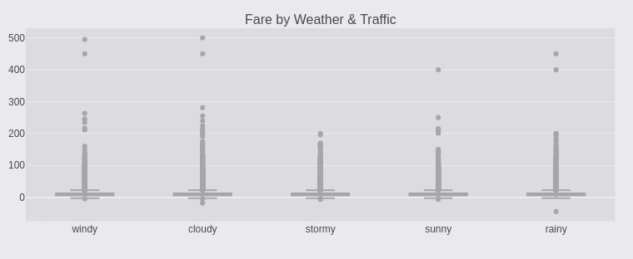
MULTIVARIATE ANALYSIS
Fare Distribution Analysis by Weather Conditions"
Explanation: This box plot displays the distribution of taxi fares across different weather conditions (windy, cloudy, stormy, sunny, rainy). The vertical spread shows the range of fares, with dots representing outliers, suggesting how weather impacts fare prices. The plot reveals significant fare variations and extreme values across all weather types.

Slide 15
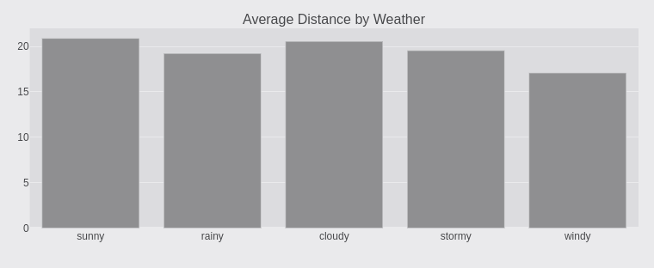
MULTIVARIATE ANALYSIS
Weather Impact on Trip Distances
Explanation: This bar chart compares the average distance of taxi rides under different weather conditions. Sunny weather shows the longest average trip distance at about 20 units, while windy conditions show the shortest at around 17 units. This suggests weather conditions may influence passengers' willingness to take longer trips.

Slide 16
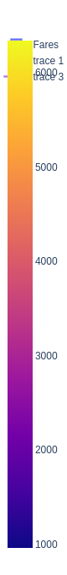
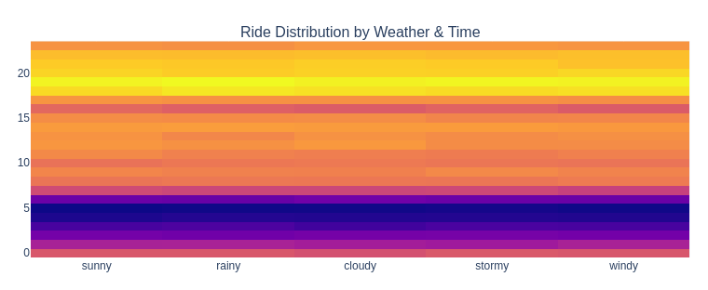
MULTIVARIATE ANALYSIS
Time and Weather Ride Density Analysis
Explanation: This heat map shows the distribution of rides across different weather conditions and time periods, using color intensity to represent ride frequency. The gradient from purple to yellow indicates increasing ride density, with the scale on the right showing the fare ranges from 1000 to 6000+. This visualization helps identify peak riding patterns under various weather conditions.

Slide 17
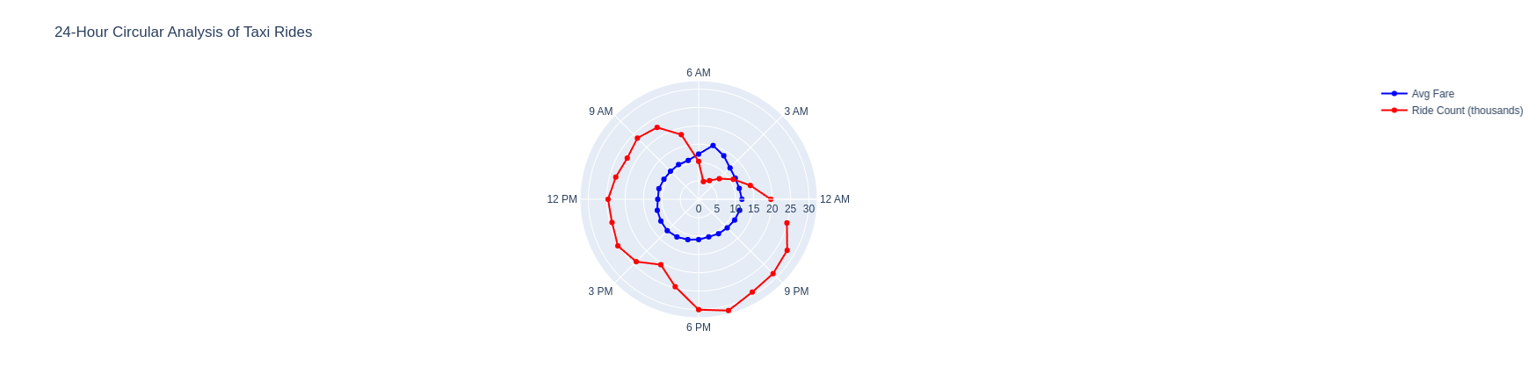
MULTIVARIATE ANALYSIS
24-Hour Ride Patterns
Explanation: This circular plot displays taxi ride patterns over a 24-hour period, with two metrics shown (likely ride count and avg fare). The blue and red lines indicate different measurements, showing how taxi activity fluctuates throughout the day. The circular format makes it easy to see peak hours and compare morning vs. evening patterns.

Slide 18
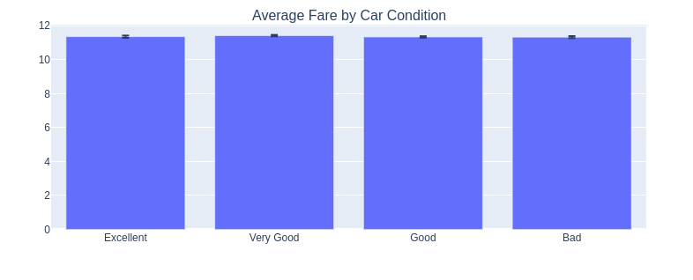
MULTIVARIATE ANALYSIS
Car Condition Impact on Fares
Explanation: This bar chart shows the relationship between vehicle condition and average fares. All conditions (Excellent, Very Good, Good, and Bad) show similar fare levels around 11 units, suggesting that car condition has minimal impact on fare pricing. This might indicate that pricing is standardized regardless of vehicle quality.

Slide 19
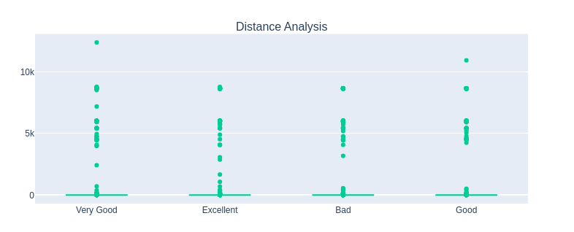
MULTIVARIATE ANALYSIS
Trip Distance by Vehicle Condition
Explanation: This scatter plot shows the distribution of trip distances across different vehicle conditions (Very Good, Excellent, Bad, Good). The dots represent individual trips, ranging from 0 to 10k distance units. There are clear outliers at higher distances, while most trips cluster in the lower range, regardless of vehicle condition.

Slide 20
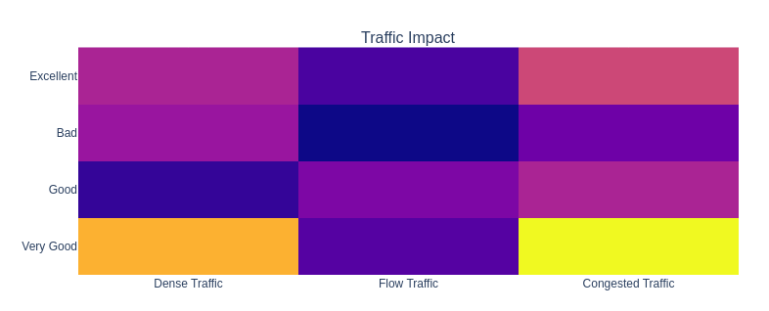
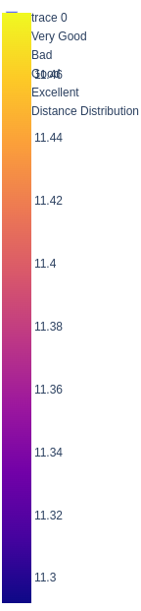
MULTIVARIATE ANALYSIS
Traffic Conditions Matrix
Explanation: This heat map displays the relationship between traffic conditions (Dense, Flow, Congested) and vehicle ratings (Excellent, Bad, Good, Very Good). The color gradient from blue to yellow indicates different intensity levels, with the scale showing values from 11.3 to higher numbers. This visualization helps identify how different traffic conditions affect vehicles of varying quality ratings.

Slide 21
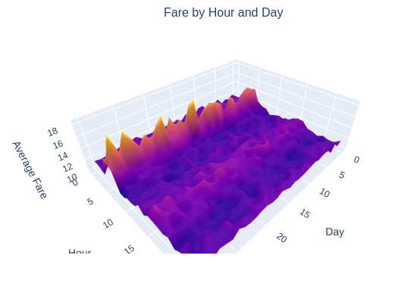
THE DASHBOARD
"HOURLY ACTIVITY HEATMAP
(3D Surface Plot): This 3D visualization shows activity patterns across hours and days of the month. Peak periods appear in warmer colors (orange/red), while quieter periods are shown in cooler colors (purple), helping identify busy times and operational patterns.

Slide 22
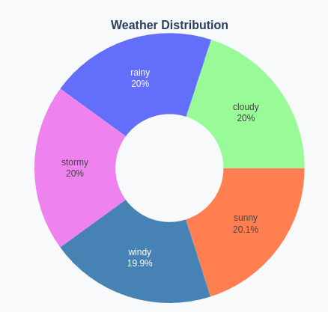
THE DASHBOARD
WEATHER DISTRIBUTION ANALYSIS
Explanation: Weather conditions are evenly distributed with rainy, cloudy, sunny, and stormy each at 20%, while windy conditions occur 19.9% of the time. This balanced distribution suggests consistent weather variability in the region.

Slide 23
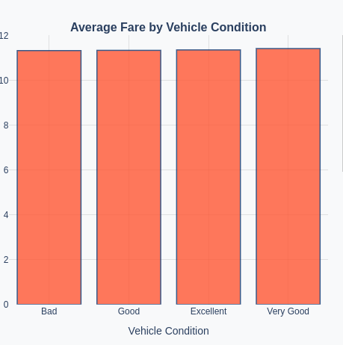
THE DASHBOARD
VEHICLE CONDITION IMPACT
Explanation: Bar graph comparing average fares across different vehicle conditions (Bad, Good, Excellent, Very Good). Interestingly, the average fare remains consistent regardless of vehicle condition, suggesting condition may not significantly influence pricing.

Slide 24
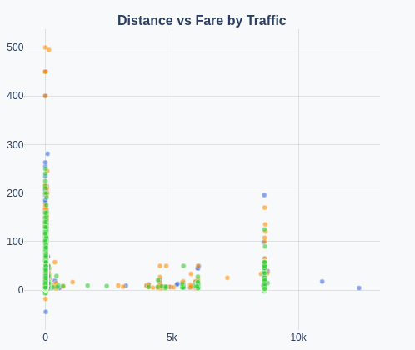
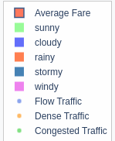
THE DASHBOARD
TRAFFIC IMPACT ANALYSIS
Explanation: Scatter plot showing relationship between distance and fare under different traffic conditions and weather patterns. Higher concentration of points at shorter distances indicates most trips are local, with varying fares based on traffic density.

Slide 25
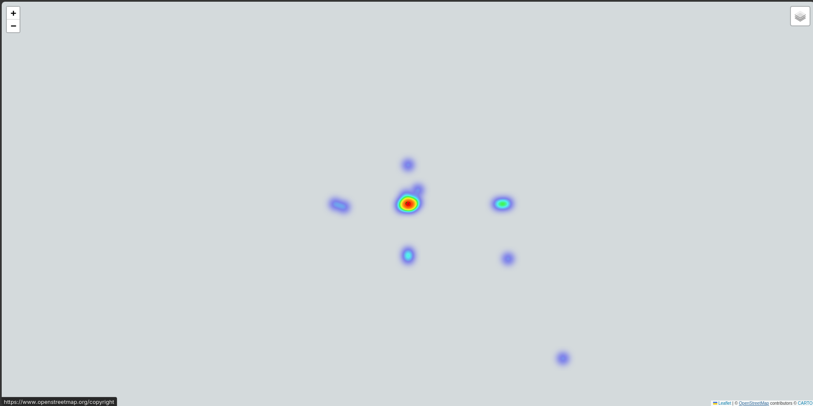
RIDES MAPPING

Slide 26
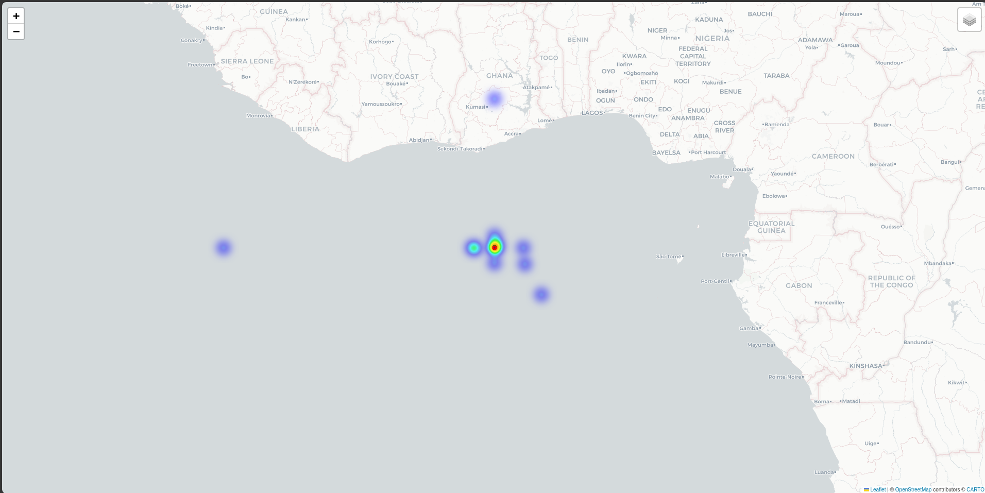
RIDES MAPPING

Slide 27
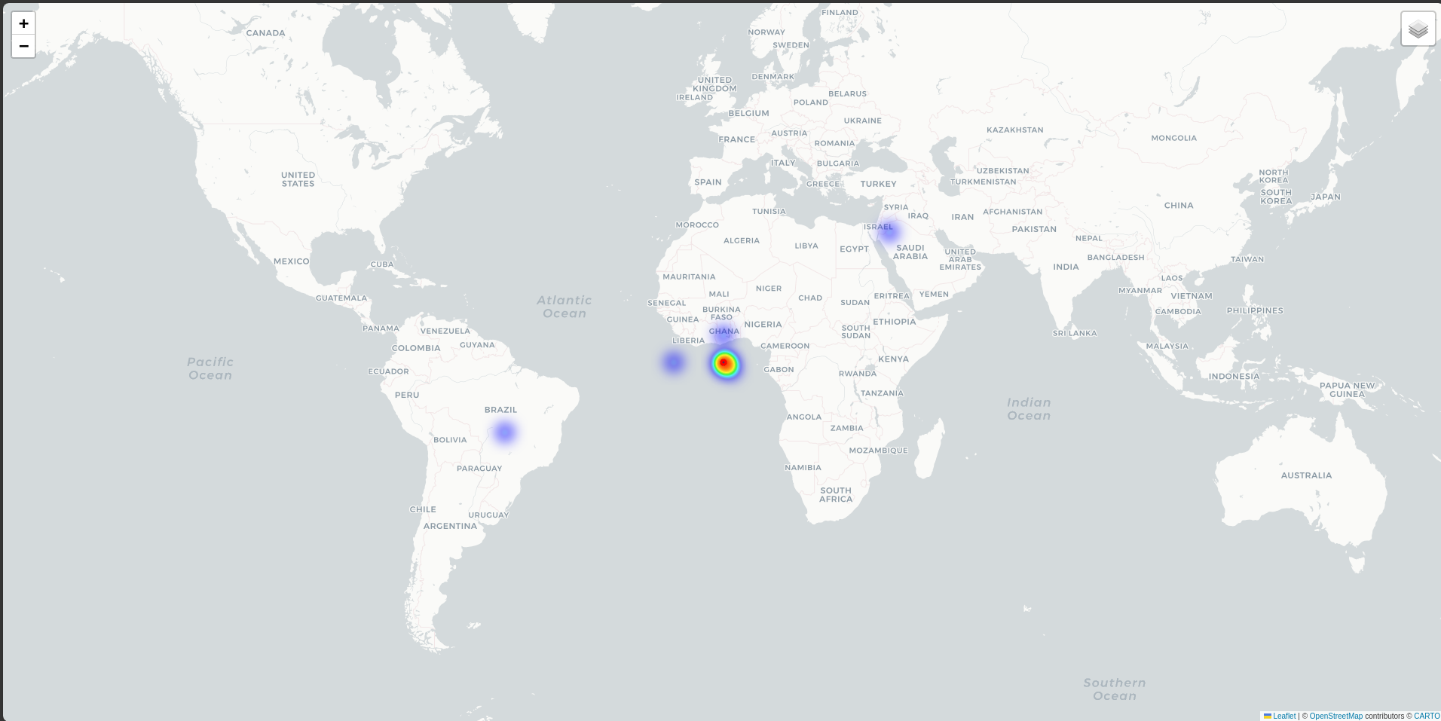
RIDES MAPPING

Slide 28
THANK YOU
for your time and attention
Present by The Team
github
G_mail

